Slide 1
TCS Response
ING SCF On boarding Portal- ING Supply Chain Finance
June 5, 2018

Slide 2

Agenda
Introduction
TCS Understanding of Scope & Objective
TCS Capability
TCS Experience
TCS Solution
Resource Structure
.

Slide 3
TCS Overview, TCS-ING Global Engagements
Introduction

Slide 4


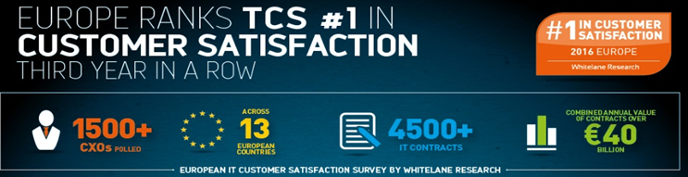

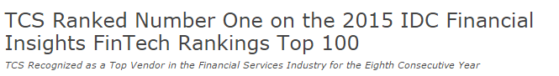
ING-TCS Relationship – 19 + years and Going Strong
By virtue of our 19+ years’ of experience working with ING, TCS has a strong understanding of ING’s ecosystem and the Way of Working
10 Countries
800+ Engineers
90 %
Current CSI
Netherlands
Belgium Germany
Serving ALL Market leaders – Netherlands, Belgium, Luxemburg
Growth Markets – Business Units in Asia
Challengers – France, Australia, Spain
Wholesale Banking
France
Italy
Spain
India
Singapore
Manila
Australia
6
7

Slide 5
TCS Understanding of Scope and Objectives
TCS Understanding

Slide 6
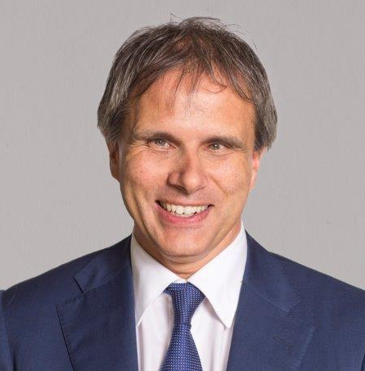
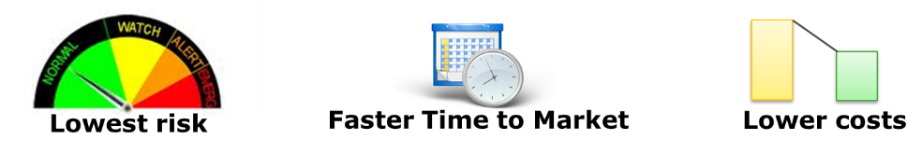
Our Understanding of your need (1/2)
Onboarding process of ING SCF program is being supported by integrated IT solution hosted in third party data center(DXC) comprising of;
Customer (Buyer & Supplier) facing web portal -> Inputting & validating supplier information
Microsoft dynamics CRM tool -> Onboarding workflow & Service request handling
ING is seeking out solution to a challenge posed by impending exit from DXC data center by November 18
“IT has an important contribution to laying foundation for further convergence that drives faster time-to-market, improve cost efficiency and improve customer experience.”

Slide 7

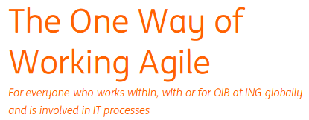
Our Understanding of your need (2/2)
In the current endeavor ING wants to move out of DXC data center with no business impact.
While the primary objective is to perform like for like migration, it should be also possible to bring-in process optimization, lay down solid technology foundation for the future and handle operational processes such as IT risk, security monitoring etc

Slide 8
Our Understanding- Scope of RFP

Slide 9
TCS Solution

Slide 10

Rollout plans
An effective and properly planned production deployment is the key for a successful migration . The type of migration , Scope migration, and size of migrations are the factors that decide the roleout plan. Some of the role out option includes
Approach 1: SCF Migration From DXC Infrastructure to ING Infrastructure.
Approach 2 : :Rebuilding SCF Onboarding Portal As Per ING and TPA Compliance.
Approach 1: SCF Migration From DXC Infrastructure to ING Infrastructure
Approach 2 :Rebuilding SCF Onboarding Portal As Per ING and TPA Compliance
Onboarding Portal
Same UI Component hosted with minimum changes in configuration related to web service call.
Onboarding Portal
Develop new UI portal based on ING Standards (Polymer)
User Access and Privileges
User access and Privileges transform and migrate.
User Access management
User authentication and authorization incorporate with TPA
Work Flow Migration
Workflow re-engineering form CRM(MS-Dynamics 2013) to Pega
Work Flow Migration
Rebuilding same business flows in Pega.
Data Model
Reconstruct of Data model based on workflow in Pega.
Data Model
Reconstruct of Data model based on workflow in Pega.
Data
Extracted ,Transform and Loaded in the new Database for Pega work flows.
Data
Extracted ,Transform and Loaded in the new Database for Pega work flows.

Slide 11
SCF Migration From DXC Infrastructure to ING Infrastructure
Source
DXC Infrastruture
Destination
ING Infrastructure
Extract
Transformation
Load
Onboarding Portal
IT Security
Portal UI Component(portlet/widget)
Portal UI Component(portlet/widget)
Configuration of Portal UI Component(portlet/widget)
Onboarding Portal
CDaaS
User Access and Privileges.
User Access and Privileges transformation.
User Access and Privileges migration or configuration.
CRM(MS Dynamics 2013)
Business Process &
Work Flows
Re-engineering of Business Process &
Work Flow.
Migration of Business Process &
Work Flow.
Pega
Business Process & Work Flow
Business Process & Work Flow
Data Model
Transformation of Data Model based on workflows
Migration of Data Model
Database
Database
Data
Transformation of Data
Data migration or configuration

Slide 12
SC Approach 2:Rebuilding Portal As Per ING & TPA Compliance
Onboarding UI Portal
TPA(Touch Point Architecture)
Onboarding UI Portal
TPA(Touch Point Architecture)
Onboarding Portal | Aligned to TPA and Micro service driven architecture.
Interfaces | Interfaces with Core Banking and Vantage (Saction Screen )
Current Technical Challenges | Re-engineering of business work flows and existing Data Migration .
Pega | For business work flows.
Automation | CDaaS Pipe Line Will be used
Testing | Automation of Regression and Performance.
ISA | OCD Approval.
Pega
Pega
Database
Automation(CDaaS)
Testing(Regression and Performance)
ISA(OCD)

Slide 13
Synergy benefits from TCS -ING teams
Onboarding Portal
Migration
Financial Market
Current knowledge on FM for end to end system & Business
TCS - ING BE
Learnings, Tools, Consulting leverage the technical Knowledge
TCS Presence in all connected system with TPA.
IT4IT
Complete Continuous Delivery, Monitoring Consulting, Innovation
Way of Working
Understanding of ING way of working & Process
TCS synergy & reusability factor will reduce the effort in the migration

Slide 14
TCS Experience

Slide 15
TCS Experience across ING
About Project
Westland Utrecht Bank (MijnWUB)
Westland Utrecht bank specializes in managing mortgages and insurance with portfolio worth € 33.8 billion.
It is Online Self service Portal thus reimagining Mortgage customer Journey through Self Service Portal for customer
Inside Business Portal (IBP)
Is strategic program to unify channel for various lines of business including Payments, Financial Market & Lending to provide omni-channel experience to customers in different countries.
It involves building functionalities for payment on IBP framework
Technology
Java/J2EE, Spring MVC, Rest API, Hibernate, JavaScript, ORACLE, DOJO, CDaaS, Sybase
Java8, Scala, Spring Boot, Spring-Data, Spring-Security, JPA, EMS, CXF, Polymer, AngularJS, HTML5, CSS3
Enhance the Customer experience by offering Online Channel insight, information, self service actions
Reduction in operational cost
Database for the WUB to manage profiling of the customer
Enhance the Customer service by offering omni channel experience
Reduction in operational cost
Value Delivered

Slide 16
TCS Experience across ING (to be updated by Prachi)
About Project
Electronic Banking (expected to be received by BE team by eod today)
PSD2 (any other service to be mentioned)
To check with Preetham
Technology
Value Delivered

Slide 17
TCS Experience in PSD2 in other European Bank
Project Description
PSD2 is a European directive as part of which banks are obliged to open up their data to third parties (TPP’S) by providing the following mandatory services:
Account Information Services (AIS), an API for requesting account info.
Payment Initiation Services (PIS), an API for initiating payments.
Confirmation on the Availability of funds (CAF), an API for balance checks for card based transactions
The business objectives of this project:
With the compliancy project Banks vision is to get compliant as early as possible.
Setup a secure environment of communication with TPP with customer authentication.
Business Process: Compliancy services to enable TPP to connect to bank directly via APIs.
Service Recipients: Any registered TPP.
TCS Solution/ Involvement
Challenges
Responsible for solution designing and building REST/ BAI services in Transaction.
Participating in building API security with OAuth2 protocols.
Responsible for building Consent portal for user.
Responsible for building administration portal for TPP.
Responsible for functional testing and integration with back end services.
Technical and detailed functional standards are not given in PSD2 RTS.
Designing an interface which is uniform and matches industry standards.
Securing APIs which is hosted over internet and exposing bank’s sensitive data.
Putting up administration to have control over TPP.
Designing a consent application, which enables Bank to authenticate a customer and take his/her consent to give authorisation to a TPP to access his/her account via APIs.
Value & Benefits
The compliancy will enforce bank to open data to TPP, which will bring creativity and innovation in the financial market.
This will accelerate the growth of Service Oriented Architecture.
This will make the rival become a partner of the bank.
Gateway dependencies will be reduced and any TPP can directly connect to the bank.
Bank will start to building new APIs which will deliver business values.
Bank can reshape itself to work as a TPP and create own features by harnessing APIs of other banks.
Project Details: PSD2
Technology Stack: Java, Oracle, OAuth2, AngularJS.
Duration: Ongoing from June 2015.
Status: Live with PSD2 APIs since January 2018. Consent to Go Live in April 2018. Go Live for NL is June 2018.

Slide 18
Key TCS Pega Implementation experiences
Customer | Engagement | Pega Modules | Advisory | Implementation | Sustenance
Large Card Issuer, North America | Global Customer Service Loyalty Platform | Pega CRM,Pega Case Management
Leading Financial Services Firm, US | Case Management and Workflow portal for Advisors and Clients | Pega CRM, Next Best Action and Marketing
Leading Insurance, Global | Global Claim Management platform and establishing a Centre of Excellence (CoE) | Pega CRM, Next Best Action and Marketing
Leading provider of network infrastructure and telecom services | Invoice management for RNAM region SAP Modernization in Sweden | Pega BPM & SAP connector
Large telecom , UK | Modernising legacy and rigid platforms Customer , business process services Automation | Pega CRM,Pega Case Management & Marketing
Key Customers Experiences
TCS Experience in Pega Modules across Customer Implementations
Business Process Automation | 40
Business Rules + Next Best Action | 10
Complex Orchestration | 15
CRM | 10
Digitization | 10
Dynamic Case Management | 20
Global Deployment | 10
Experiences in Pega Modules
TCS Pega Customers: 40

Slide 19
Relevant Experience Highlights
Customer | Project/ Program details | Team Size and Composition | Benefits to ING
Large UK Customer | Retail Business Processes Simplification through Pega Implementation under themes Straight through processing, Semi-automated and Expert handling Over 300+ processes transformed through Pega platform under above themes integrating with 100+ systems Account transfer, FATCA, Fraud Transactions management , Court Order processes and others All projects executed in Agile delivery Application development experience in shared environments with other Pega service integrators before TCS announced as single Pega delivery partner 100+ FTEs reduction Reduction in TAT of 50+ percent for any processes Pega upgrade to 7.x version | 100+ members Team size Managed Service engagement including IT operations. Onsite –offshore model with onsite to offshore ration 20 : 80 Single Pega Delivery Partner | Ability to scale at onsite and offshore Low cost of ownership Agile delivery with multiple scrum teams execution in parallel Leverage TCS Experience working in multi vendor Pega application development environments Leverage largest Pega implementation in Europe. Helped to reduce technology debt for implementation. Leverage TCS Pega upgrade experience
Large Australian Bank | Process Automation of customer on-boarding, account origination and home loan lending was manual with inefficient work flows. Consolidate and create a streamlined customer on-boarding and Loan origination common business processes to establish “one-way same-way” for all account originations. Home loans can be conditionally approved in 1 day. | 10+ Team Size Execution of Staff augmentation and Fixed price delivery models. Part of Customer Pega COE | Leverage TCS Mortgage Process automation experience
Large Canadian Customer | Multi Product Sales and Origination (MPSO) is a multi-year enterprise program consolidating and modernizing sales & origination systems and processes for bank retail banking products like Cards, deposits, Mortgage, Loans with iintegration with 30 disparate systems. Decision Management implementation for Lending Adjudication, Multiple Product Offering Under Single Owner,Next Best Action Marketing – Credit Card Division 30% uplift in Sales as compared to the 5% projected uplift as per the Business Case DCO sessions enablement of Business teams by TCS Pega COE Pega upgrade to 7.x version | 90+ Team size managing Development and QA delivery E2E including Performance Testing, Automation and Manual Testing | Leverage TCS ability to scale from Pega platform to Decision Management capabilities Leverage TCS Pega upgrade experience Leverage Pega COE for thought leadership sessions

Slide 20
TCS-ING Relationship (PEGA) Journey so far...
Sep’15
Jan’16
Jun’16
Jul’16
Aug’16
Oct’16
Nov’16
Dec’16
Engagement
Kick-off (FPM)
Engagement
Kick-off Pega Smart Investigate for Payments
Technical Analysis for ‘Communication via Email’
TCS becomes the single preferred vendor for PEGA at ING BE
Proposal for Upgrade of application
Offshore set-up
TCS’ PEGA Expert as Scrum Master
CDH engagement kick-off
PEGA selected as tool to Handle Case Management in WBS.
TCS to support the upgrade and in Global Roll-out, Handle Payments Investigations
Key Highlights:
15 FTE supporting the Communication Manager (PEGA) engagement at ING BE
Transitioned from Pega Systems
Onsite- Offshore delivery model to achieve cost benefits with 50% offshore leverage as of date
Implementation of ‘Payments Automation’ to reduce FTE's and Manual errors for handling payments investigations
Value Additions:
Recommendations for Training Plan for Business and IT teams in ING, leading to direct cost savings
Common Foundation Framework Validation and recommendations report with design gap analysis and recommendations with involvement of TCS’ Centre of Excellence
Proof of Concept for Nolio & Pega integration for Deployment Automation aligning to DevOps principles
Fixed price offshore driven work package for implementation of Communication via email to achieve cost benefits with end-to-end delivery ownership
To be updated by Preetham with NL details

Slide 21
TCS Capability

Slide 22
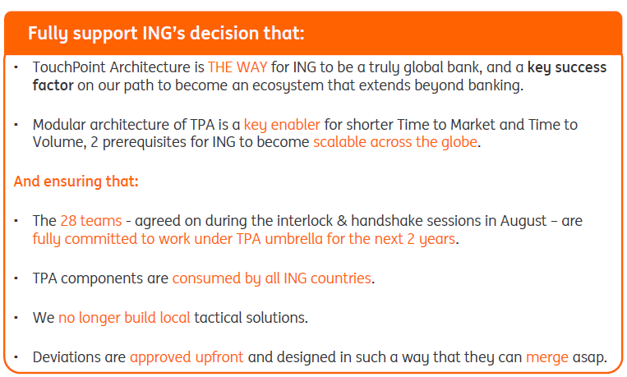
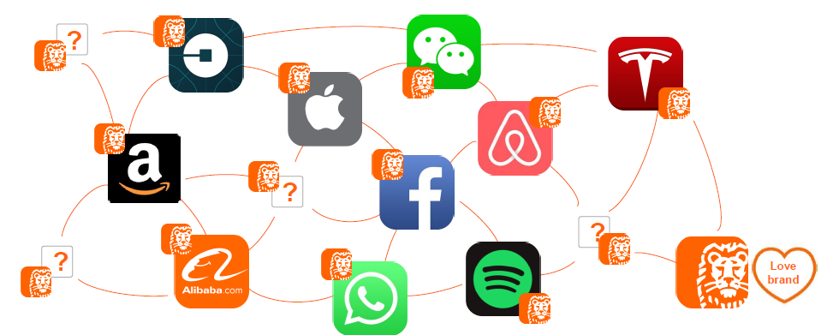
Touch Point Architecture

Slide 23
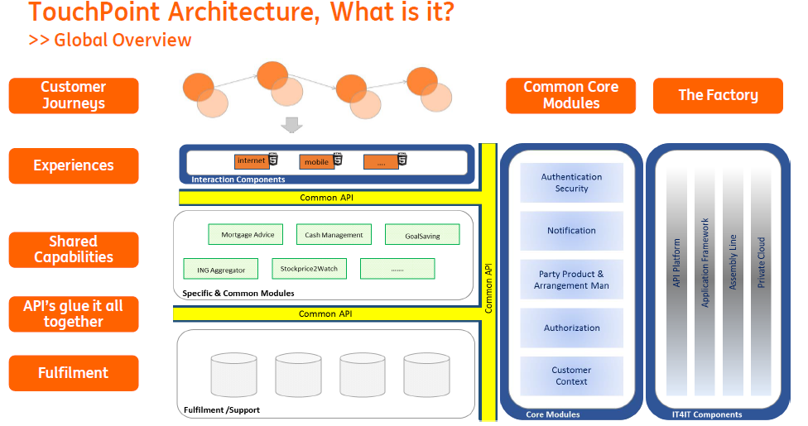
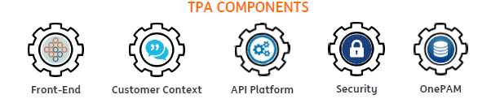
Touch Point Architecture

Slide 24
Continuous Delivery as a service
Project Details : GBS is a Wholesale core banking application hosted on HP Non Stop Blades Server. It supports banking products like Customer & Account Management, Funds Transfer, Capital Markets, Foreign Exchange, Lending, Finance and Reporting for 5 Europe Branches. TCS @ ING GBS has been providing maintenance and enhancement for the GBS application from Mumbai and Netherlands.
Commencement Date: Ongoing Project incepted in Feb 2003
Team Size/Locations: 9 Distributed (4 NL / 5 IN)
Delivery Model : Onsite / Offshore
Delivery Methodology : Agile Scrum
Engagement Model: Fixed Price
Customer Satisfaction score: 91,79%
Technology Stack : > HP Non Stop Tandem Servers and utilities hosting vendor delivered GBS
> Guardian OS
> Database - Enscribe and SQL MP ,
> Programming Language - COBOL, TAL , TACL
Tools used: SNOW, HP ALM, JIRA, Win6530 Terminal emulator for Tandem mainframe, Confluence, ING Share point
Value delivered: Automation of System Backup and Refresh.
Business Line: Core Banking - Funds Transfer, Capital Market, Foreign Exchange, Lending, Finance, Reporting.
Applications Supported: GBS (Vendor Delivered)
Scope of Services:
Assess and evaluate requirements
Techno-Functional & Impact analysis, provide technical solution
Development, Unit testing/Functional testing and Quality Assurance
Release / UAT coordination, Second Line support
DT Environment management.
Service Window:
09:00 to 18:00 CET In-House, weekdays.
18:00 to 06:00 CET Stand-by, weekdays.
24 * 2 Stand-by support, weekends.

Slide 25

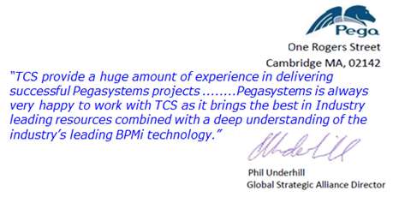
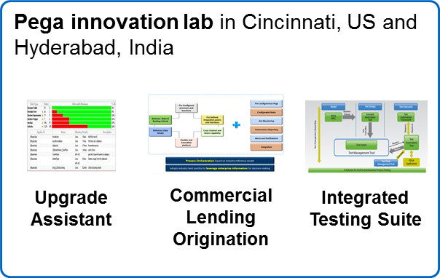
TCS capabilities in PEGA- snapshot
Experience
People
Innovation Labs
Services
Competency Development
R&D, Investments
Strategic
Consulting
Partner
Evaluated and Recommended by Gartner and Forrester for BPM services
40+ major active clients on PEGA
No pega Customer Attrition in
BFS
Pega implementations at TCS since 2001
1900+ Pega certified,
200+ Chordiant consultants
50+
Pega Decision Management Consultants
TCS Pega Lab in Cincinnati and Hyderabad with latest Pega platform & applications
End-to-End Pega Consulting and ADM services
Pega Upgrades achieved for 10+ customers
>90% CSI achieved
Leverage Pega Academy and ICALMS
2000+ Courses and 90,000+ Lessons Completed
50+ Pega Tools and Accelerators
Industry solutions
Sponsor of Pega Digital events and forums
Received Business Transformation in Communications, Partner Excellence Award , Customer Success in Financial Services, Market Development Award from Pegasystems
Winner of the Business Transformation Award in Communication and Media Industry by Pega Systems
TCS has highest level of Partnership with Pega, Strategic Consulting Partners
TCS is Second Largest Pega Services provider across the Globe

Slide 26
Way of working

Slide 27
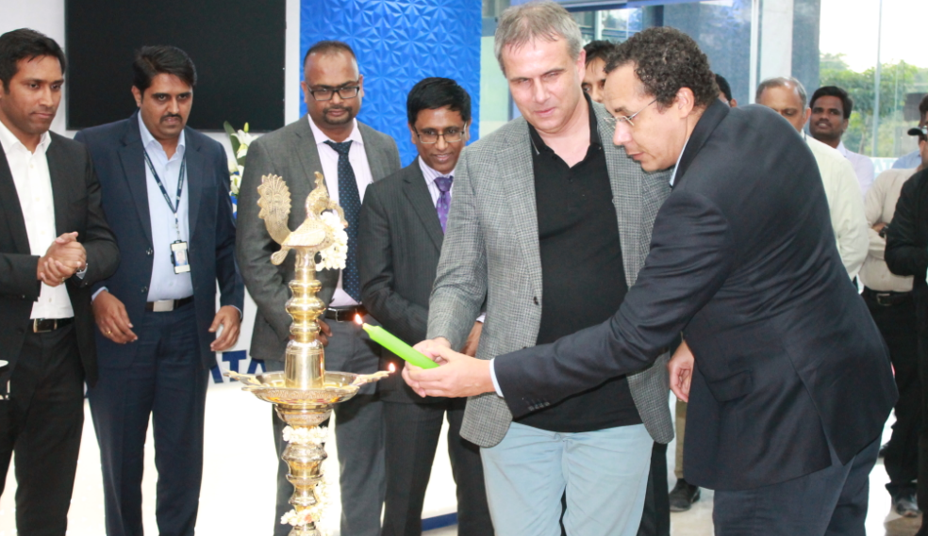
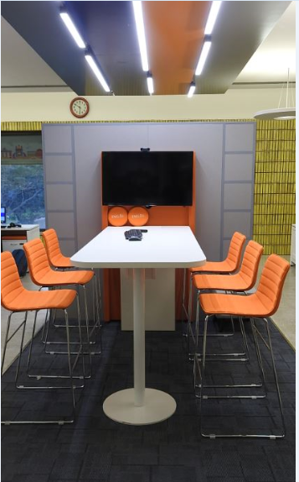
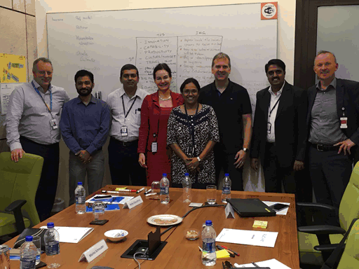
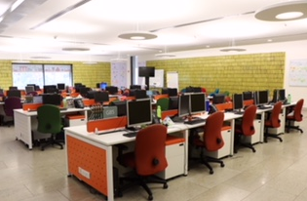
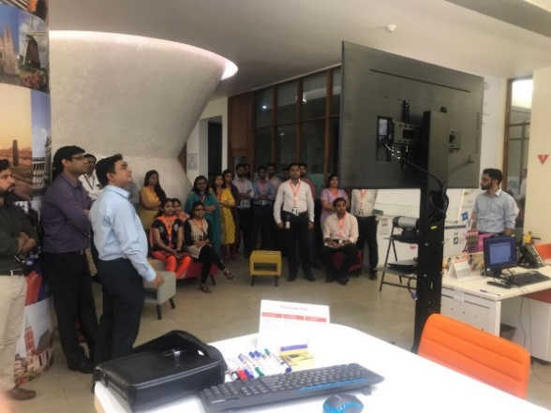
Successful Distributed Agile WoW
3

Slide 28
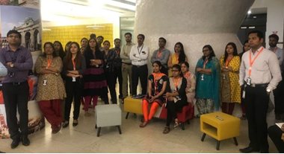
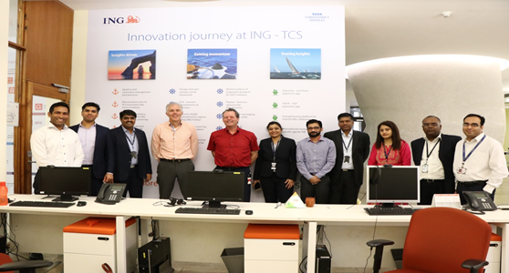
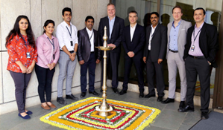
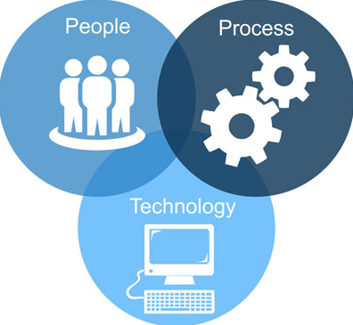
Learnings from similar transition experiences within ING
Teams
WUB, IB
Electronic Banking, ING Belgium
Highlights
In-house and vendor products
High offshore leverage
Varied technologies
Diverse skillsets

Slide 29
Team Structure

Slide 30
Preetham and Prachi to update

Slide 31
Support needed from ING

Slide 32


Support Needed from ING

Slide 33
Future roadmap (backlog)

Slide 34
Preetham to update

Slide 35
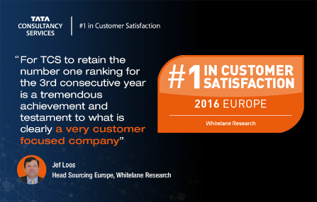

Thank You
“Innovation is more important than ever to survive in a fast changing world. ING has always been able to stay a step ahead and even to disrupt the financial Industry. To keep on delivering a differentiating experience to our customers, we have to work with partners with similar high ambitions and a forward-thinking mentality. TCS has been of great added value to help us accelerating Innovation so far.”
Ignacio Julia Vilar
Chief Innovation Officer and Head of Retail Banking Segment, ING Group

Slide 36
Appendix

Slide 37
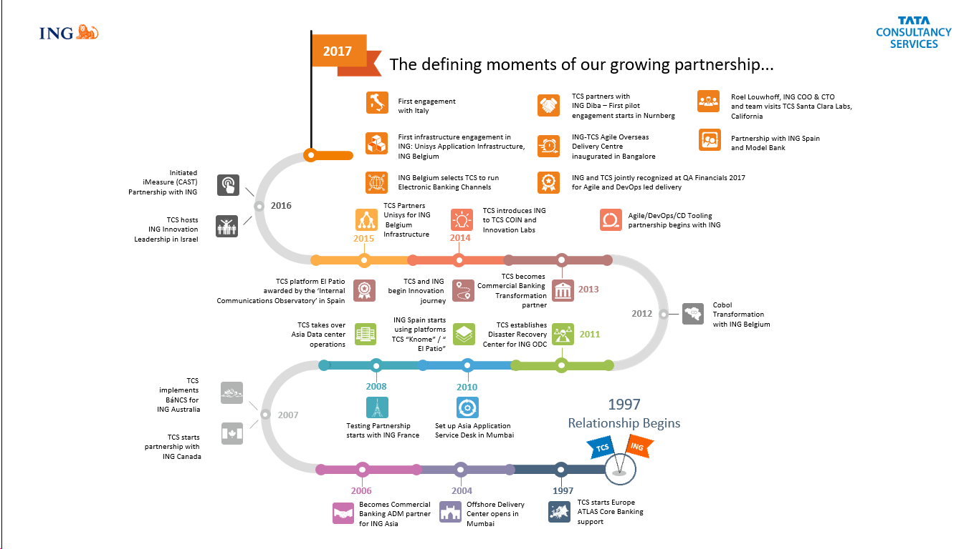
ING-TCS Relationship Journey

Slide 38
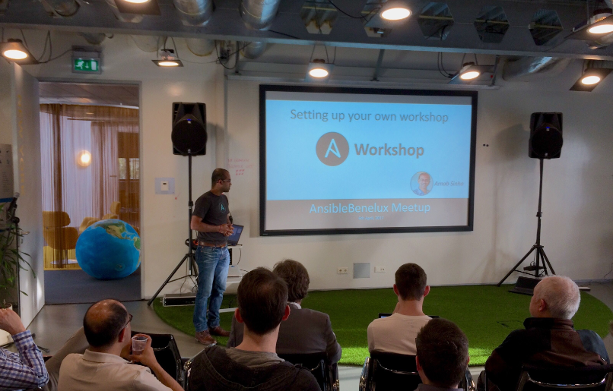
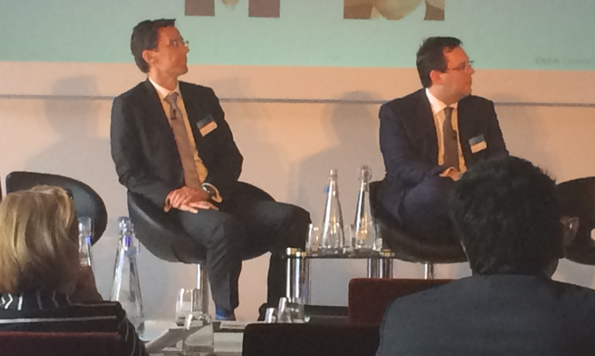

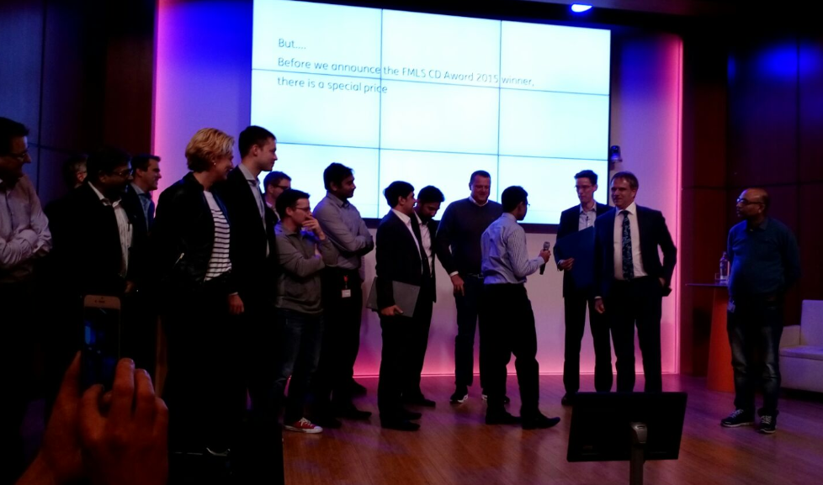
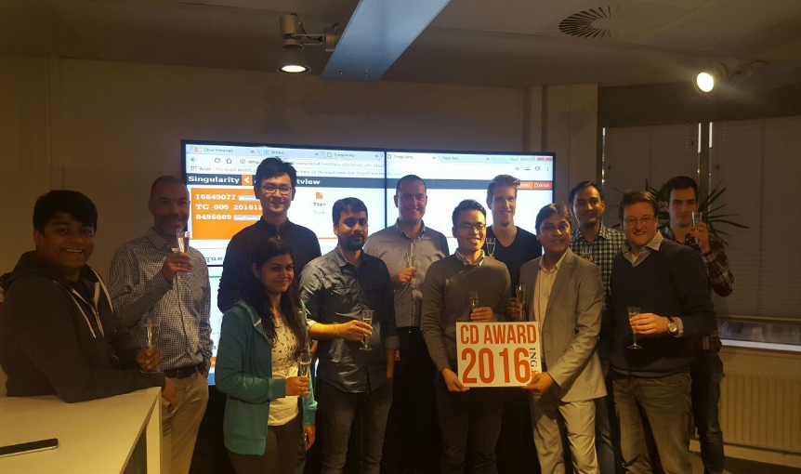
TCS & ING – Collaborating on the Next Gen Solutions
TCS & ING at Benelux Ansible Meet, 6th April 2017
Voice of Customer : Peter N, Head Global Markets & Lending at TCS UK Innovation Forum . Spoke on DevOps and Antipatterns & TCS as an Agile Partner
“Innovation is more important than ever to survive in a fast changing world. ING has always been able to stay a step ahead and even to disrupt the financial Industry. To keep on delivering a differentiating experience to our customers, we have to work with partners with similar high ambitions and a forward-thinking mentality. TCS has been of great added value to help us accelerating Innovation so far.”
Ignacio Julia Vilar
Chief Innovation Officer, ING Group
Continuous Delivery Awards 2015 Global Financial Markets & Lending)
TCS team awarded trip it to Silicon Valley ( Awarded by Ron Van Kemenade, Group CIO)
Continuous Delivery Awards 2016 Global Financial Markets & Lending) - TCS & ING Team joint winner

